Slide 1

Connecting R to the Good Stuff!
Joseph B. Rickert
RStudio R Community Ambassador

Slide 2
The Nature of R
“One of the attractions of R has always been the ability to compute an interesting result quickly.
“A key motivation for the original S remains important now: to give easy access to the best computations for understanding data.”
John Chambers: Extending R, CRC Press
The top half John Chambers’ famous diagram from that afternoon in May 1976 indicates their intention to design a software interface so that one could call an arbitrary Fortran subroutine, ABC, by wrapping it in some simplified calling syntax: XABC( )

Slide 3
Connecting to The Good Stuff
R
Languages
Python
Stan
C++
Platforms
TensorFlow
Spark
Databases
SQL
DBI
Data Sources
Web
Shiny
DSL
CVX
Tidyverse
NIMBLE
Data Structures
Apache Arrow
Methods of Connecting
Simple Import / API
Database connections
DSL
Language Interfaces
Sharing Data structures

Slide 4
Reticulate Package: R Interface to Python
reticulate provides a comprehensive set of tools for interoperability between Python and R:
Embeds a Python session within your R session
Call Python from R: using R Markdown by sourcing Python scripts by importing Python modules interactively within an R session.
Translation between R and Python objects (e.g., between R and Pandas data frames, or between R matrices and NumPy arrays).
Bind to different versions of Python including virtual environments and Conda environments.
blog.rstudio.com/2018/03/26/reticulate-r-interface-to-python

Slide 5
Leveraging Reticulate
TensorFlow
Python
Greta
reticulate
XRPython
Commercial solvers
Deep Learning
CVXR
docker
Black – R package
White - Resource

Slide 6

A probabilistic programming language for Bayesian inference and optimization
Stan programs compute the log-posterior density
Code is compiled and run with data
Result is a set of posterior simulations of the model
Uses the no-U-turn sampler, an adaptive variant of Hamiltonian Monte Carlo
Run from R with rstan package

Slide 7
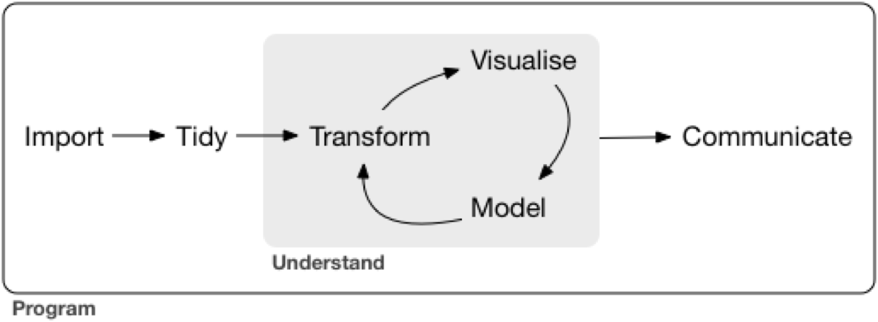
Tidyverse: A DSL For Data Science
The Tidyverse is
A coherent system of packages for data manipulation, exploration and visualization
Share a common design philosophy
Intended to make statisticians and data scientists more productive by guiding them through workflows
Facilitate communication
Result in reproducible work products

Slide 8
CVXR is a DSL for formulating and solving convex optimization Problems
CVXR provides an object-oriented modeling language for convex optimization. It allows the user to formulate convex optimization problems in a natural mathematical syntax rather than the restrictive form required by most solvers.
https://cvxr.rbind.io/
https://rviews.rstudio.com/2018/07/09/solver-interfaces-in-cvxr/

Slide 9
NIMBLE Numerical Inference for Statistical Models Using Bayesian and Likelihood Estimation
A DSL for Hierarchical Models
Built on R
Uses BUGs Language
Separates Model from Algorithms
Separates Setup from Model Execution
Compiles R Code
https://rviews.rstudio.com/2018/07/05/a-first-look-at-nimble/

Slide 10
Web Connectivity and Javascript Visualizations
Interactive Web Integration:
Shiny
Web Scraping:
Rcrawler (https://bit.ly/2J8rmhW)
Rvest
JavaScript Visualizations
r2d3 - R Interface to D3 Visualizations
Htmlwidgets (https://www.htmlwidgets.org/)

Slide 11
DataBase Connectivity
Analyze in database with dplyr
The DBI package provides a common interface that allows dplyr to work with many different databases using the same code.
The R Consortium is is funding work to improve DBI (https://www.r-dbi.org/).
DBI is automatically installed with dbplyr.
MS SQL Server and Access
Oracle
Apache Hive and Impala
Postgress SQL and MariaDB (MySql)
Amazon Redshift
Teradata
Google Bigquery

Slide 12
Ursa LABS & The Apache Arrow Project
Arrow Memory
R
Impala
HBase
Python
Spark
Cassandra
C++
JavaScript
Language-independent memory structures
Columnar format for flat and hierarchical data
Better performance on CPUs and GPUs

Slide 13
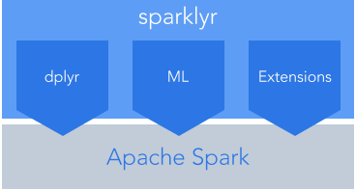
Sparklyr: R interface for Apache Spark
Connect to Spark from R
Dplyr backend
Filter and aggregate Spark datasets
Run Spark’s MLlib models
Create extensions the call the full Spark API
Connect the the Databricks Unified Analytics Platform
Take advantage of parallelism

Slide 14
Tensorflow
Tensors (arrays) flow through a dataflow graph where nodes represent units of computation.
Applications:
Deep Learning
Bayesian Modeling
And More
A general purpose numerical computing library
Developed by the Google Brain Team
Open Source (Apache v2.0 license)
Hardware independent:
CPU (via Eigen and BLAS)
GPU (via CUDA and cuDNN)
TPU (Tensor Processing Unit)
Supports automatic differentiation
Distributed Execution for large datasets

Slide 15
R Packages for Tensorflow
TensorFlow APIs
keras—Interface for neural networks, with a focus on enabling fast experimentation.
tfestimators— Implementations of common model types such as regressors and classifiers.
tensorflow—Low-level interface to the TensorFlow computational graph.
tfdatasets—Scalable input pipelines for TensorFlow models

Slide 16
Deep learning
A machine learning technique for classification and prediction
”Learns” by transforming data through many layers of representations
Data transformation functions are parameterized by weights

Slide 17
Bayesian Modeling
Write statistical models in R and fit them by MCMC on CPUs and GPUs, using Google TensorFlow

Slide 18
Some Links
Code Examples in Repo:
TF_Neural_Net_Keras - uses Keras and TensorFlow to classify MNIST image data
TF_Core_Regression – Implements basic multiple regression model in TensorFlow
R_sparklyr_Spark – Shows how to use sparklyr package to run simple models on Spark
Nimble-ex_v2 – uses NIMBLE to solve Bayesian Hierarchical Model with Pump Data
Stan_logistic_reg – Fits a logistic regression with Stan
Apache Arrow - https://arrow.apache.org/
CVXR - https://cvxr.rbind.io/
Database connectivity - https://db.rstudio.com/databases/
Greta - https://greta-dev.github.io/greta/
NIMBLE - https://r-nimble.org/
Reticulate - https://rstudio.github.io/reticulate/
R2d3 - https://github.com/rstudio/r2d3
Shiny - https://shiny.rstudio.com/
Sparklyr - http://spark.rstudio.com/
TensorFlow - https://tensorflow.rstudio.com/
Ursa Labs - https://ursalabs.org/
For code examples look here: https://github.com/joseph-rickert/useR_2018

Slide 19
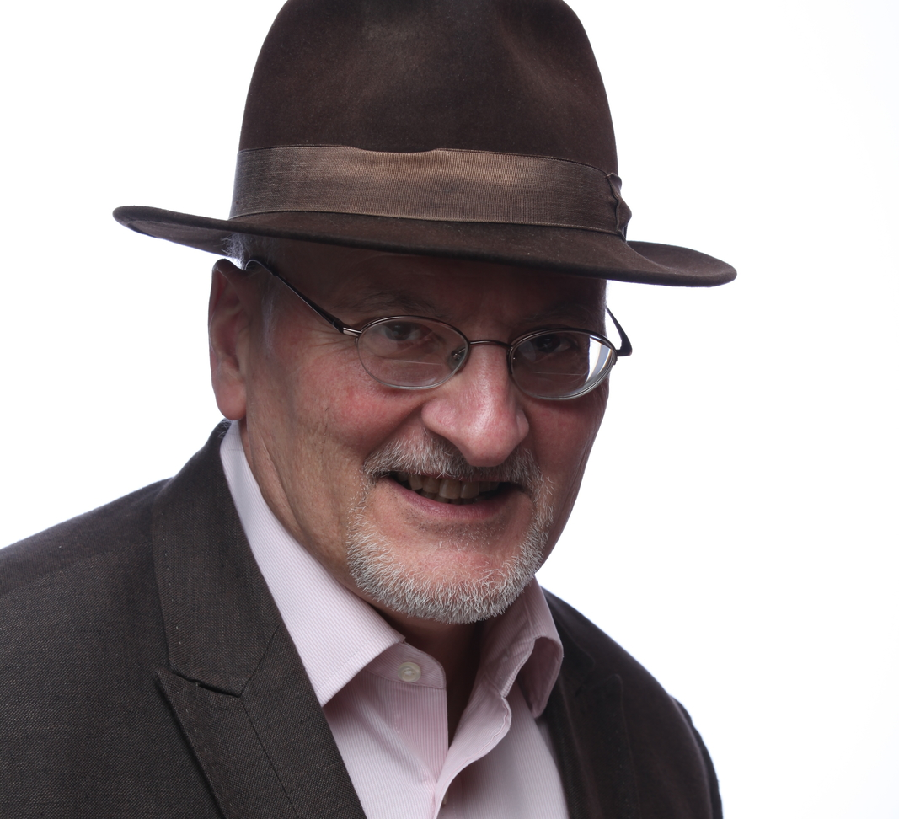
R continues to reinvent itself
Thank you
Joseph.rickert@RStudio.com
@RStudioJoe

Slide 20
Connecting R to the Good Stuff
In his book, Extending R, John Chambers writes:
One of the attractions of R has always been the ability to compute an interesting result quickly. A key motivation for the original S remains as important now: to give easy access to the best computations for understanding data.
R developers have taken the challenge implied in John’s statement to heart, and have integrated R with some really “good stuff’ while providing easy access that conforms to natural R workflows. Rcpp and Shiny, for example, are both spectacularly successful projects in which R developers expanded the reach of R by connecting to external resources.
In this talk, I will survey the ongoing work to connect R to “good stuff” such as the CVX optimization software, the Stan Bayesian engine, Spark, Keras and TensorFlow; and provide some code examples including using the sparlkyr package to run machine learning models on Spark and the keras package to run deep learning and other models on TensorFlow.

